Slide 1

Context
Story behind the Robot

Slide 2



Slide 3
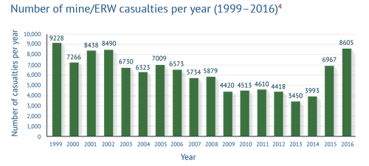
http://www.the-monitor.org/en-gb/reports/2017/landmine-monitor-2017/casualties.aspx, https://en.wikipedia.org/wiki/List_of_terrorist_incidents

Slide 4
Bombie
A Gesture Controlled Bomb Defuser
26 - 10 - 2018

Slide 5





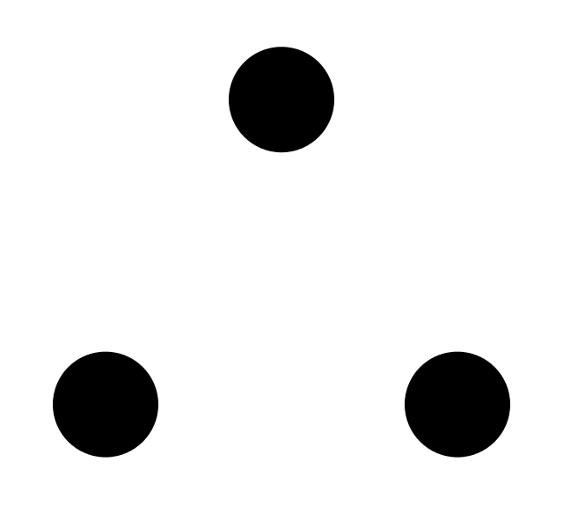
Content
Context
Design & Features
Demonstration
Software
Hardware
Conclusion
Process

Slide 6
Design & Features
Specs

Slide 7
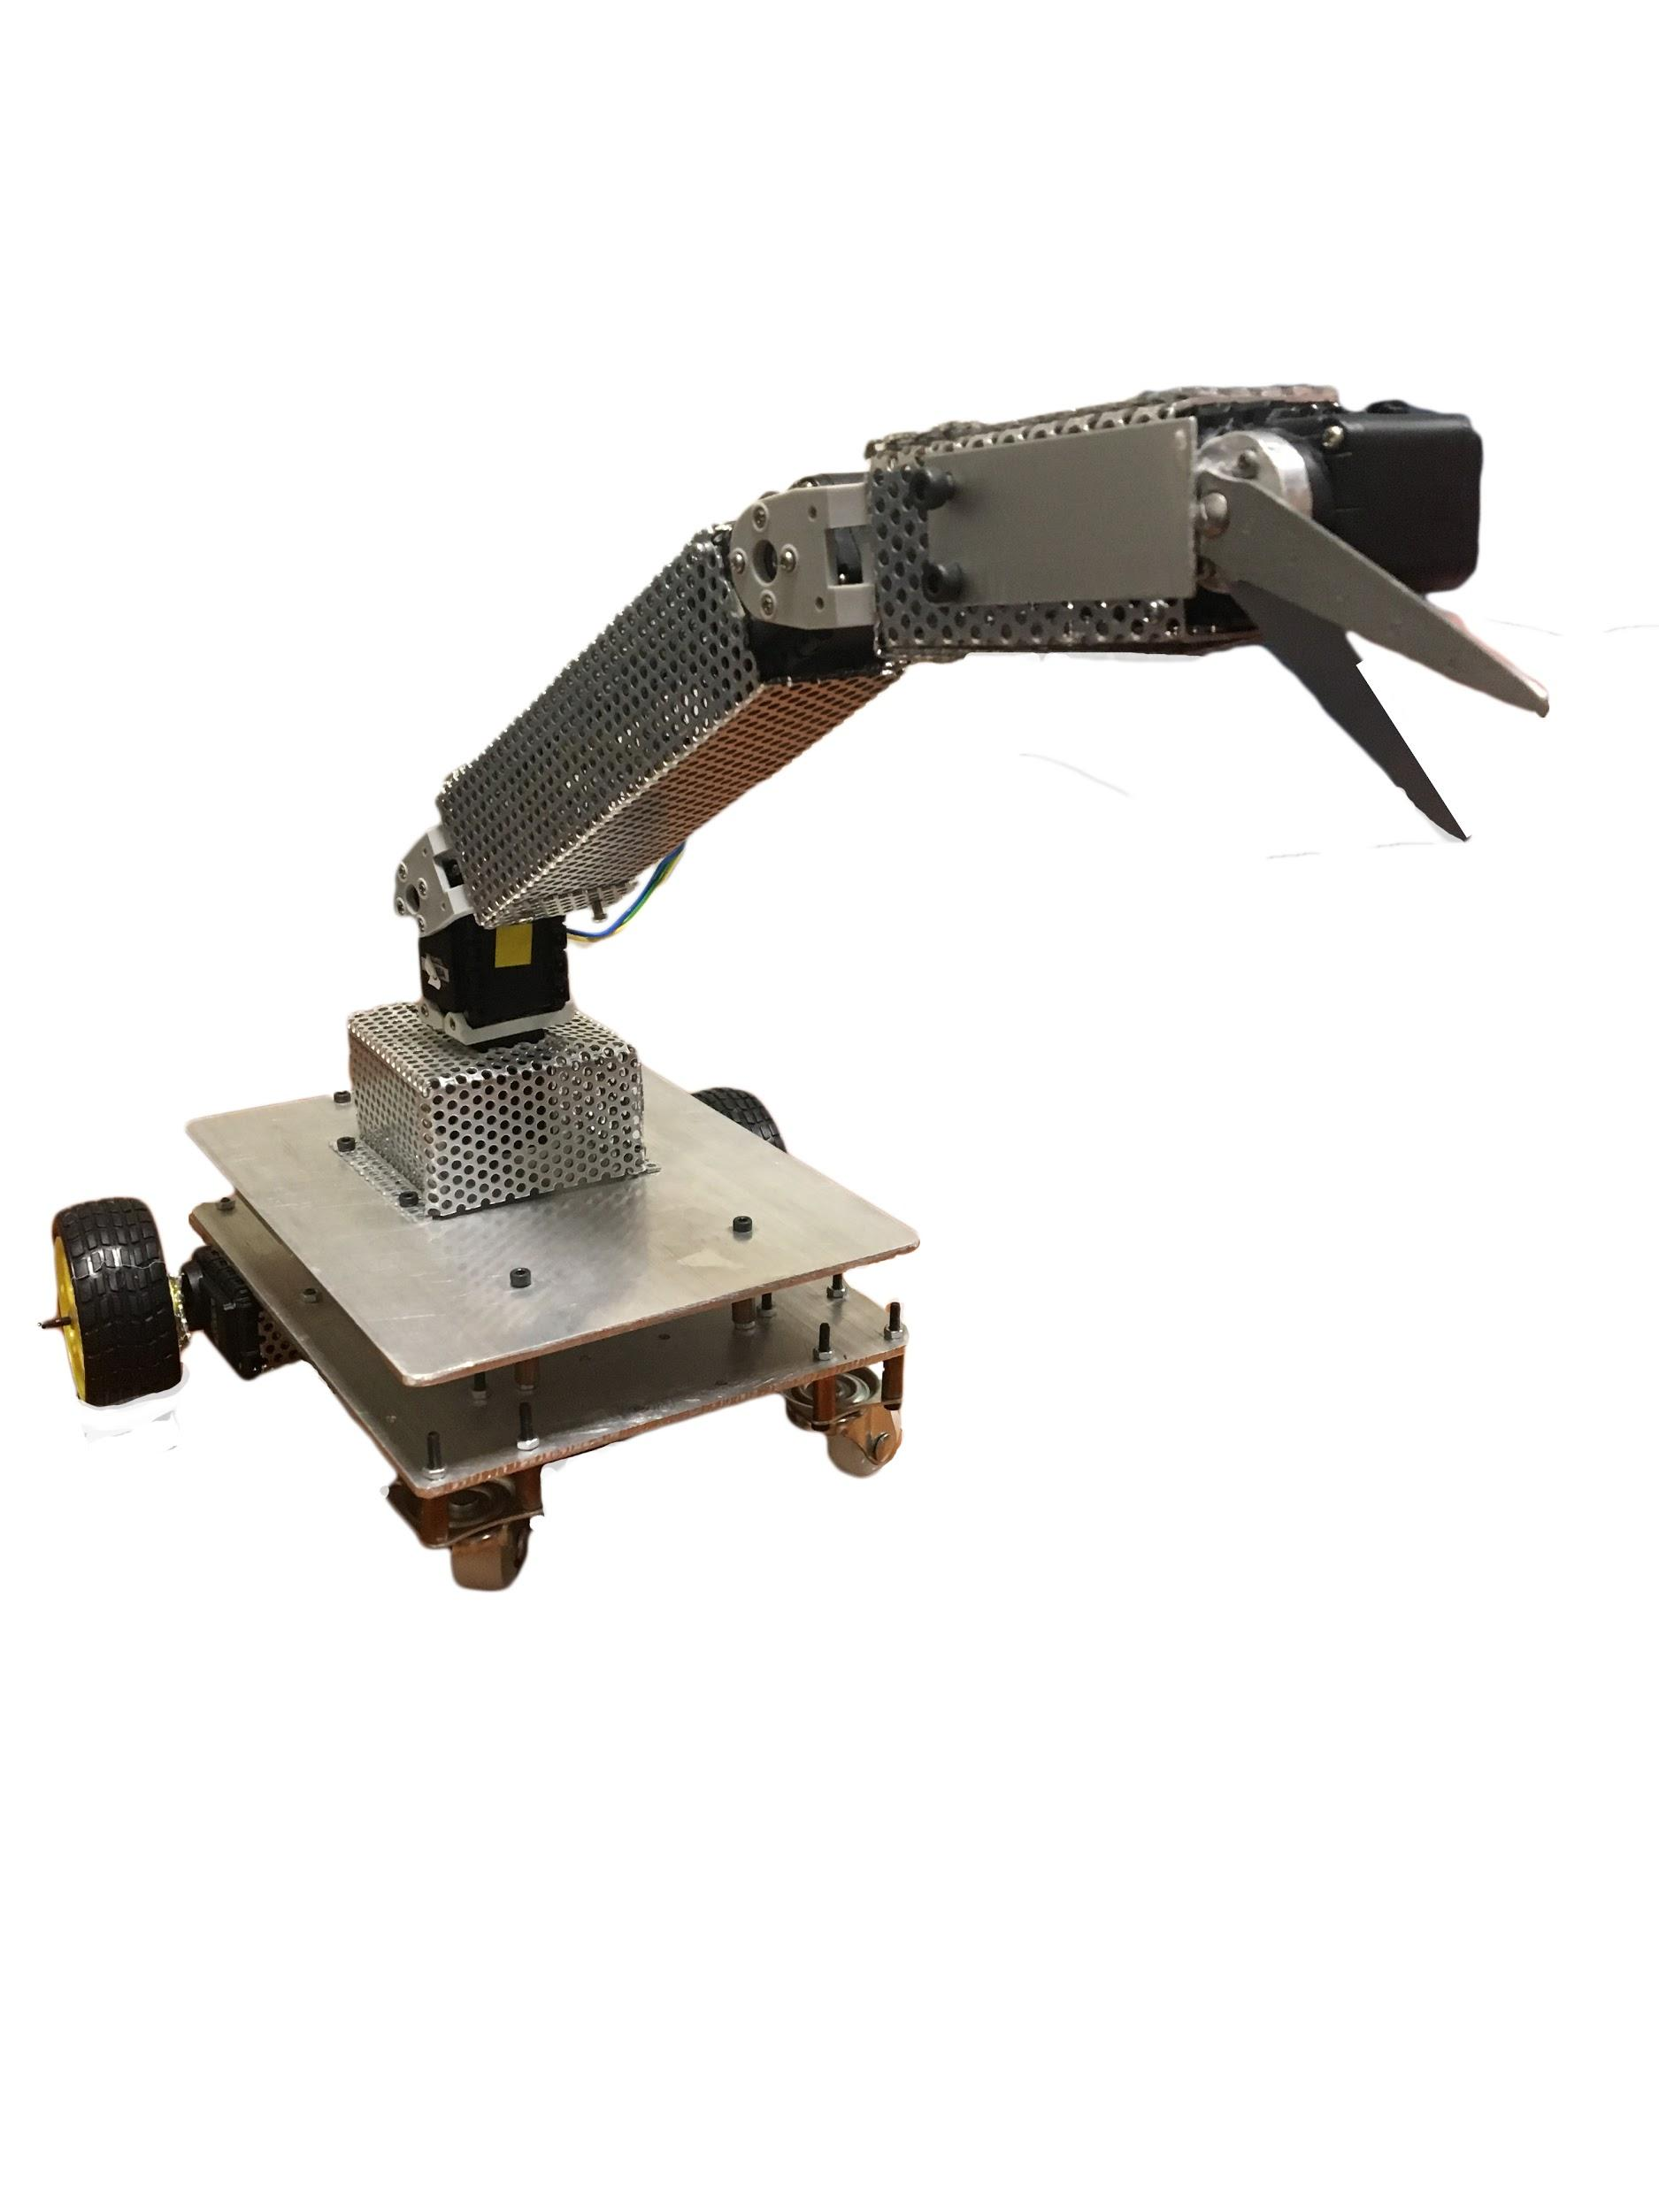
Drive
Inverse Kinematics
Defuse
Smart
Controllability
Notes:
Smart ← Neural Networks

Slide 8
Content
Context
Design & Features
Demonstration
Software
Hardware
Conclusion
Notes:
“I know you’re wondering how and what’s behind all of this?

Slide 9
Demonstration

Slide 10
Hardware
Closer look at the car and arm

Slide 11
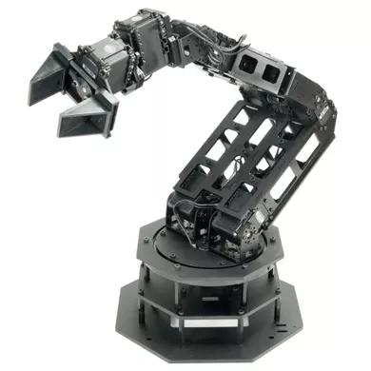
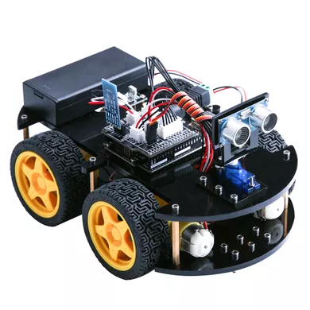
Hardware: Design
Two parts: Car and Arm
Car team + Arm team
6x Dynamixel Robot Servo, AX-12A
Solidworks

Slide 12
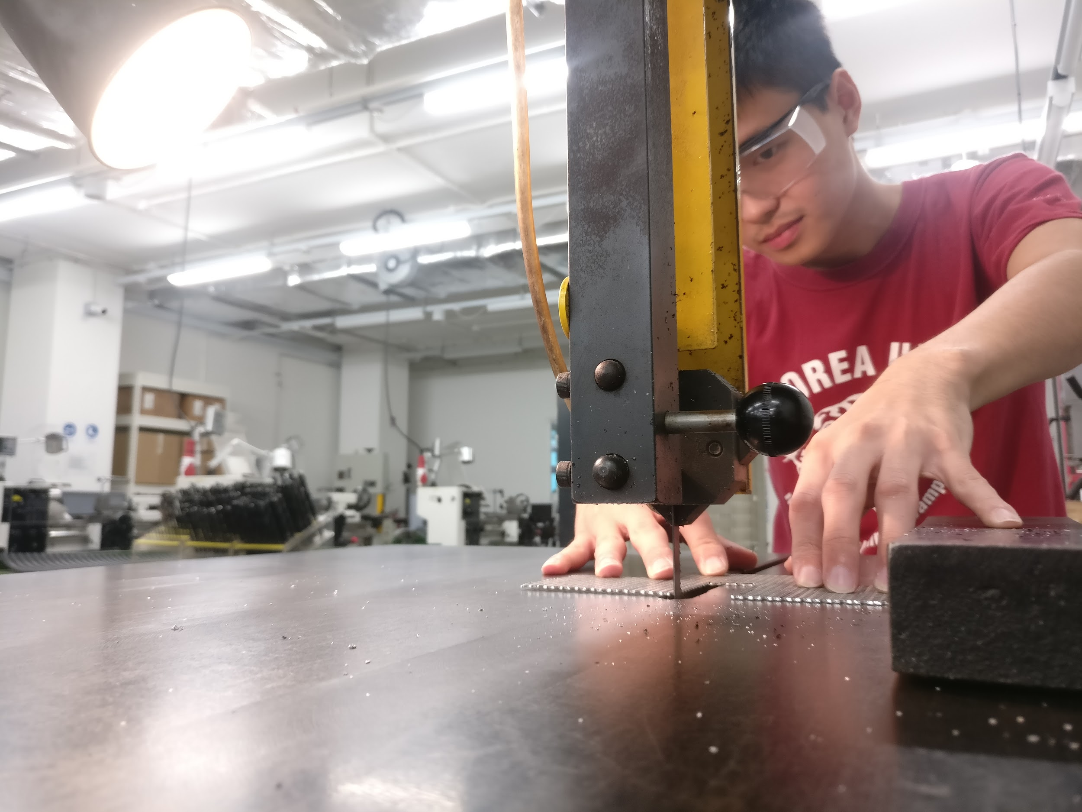
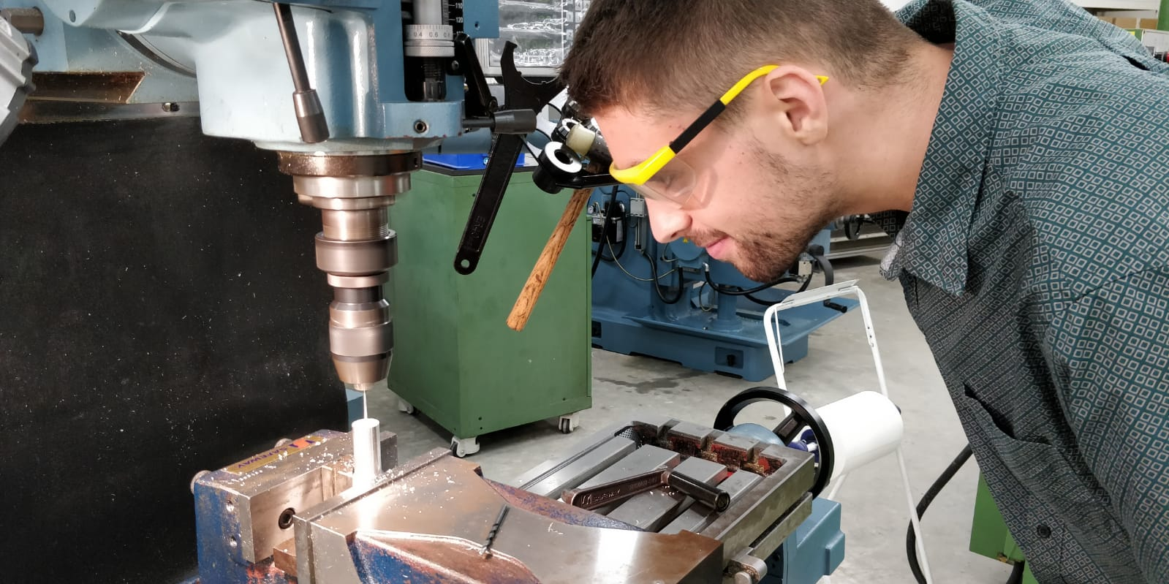
Hardware: Production
Aluminium
Methods:
Bending
Drilling
Milling
Cutting
Sawing

Slide 13
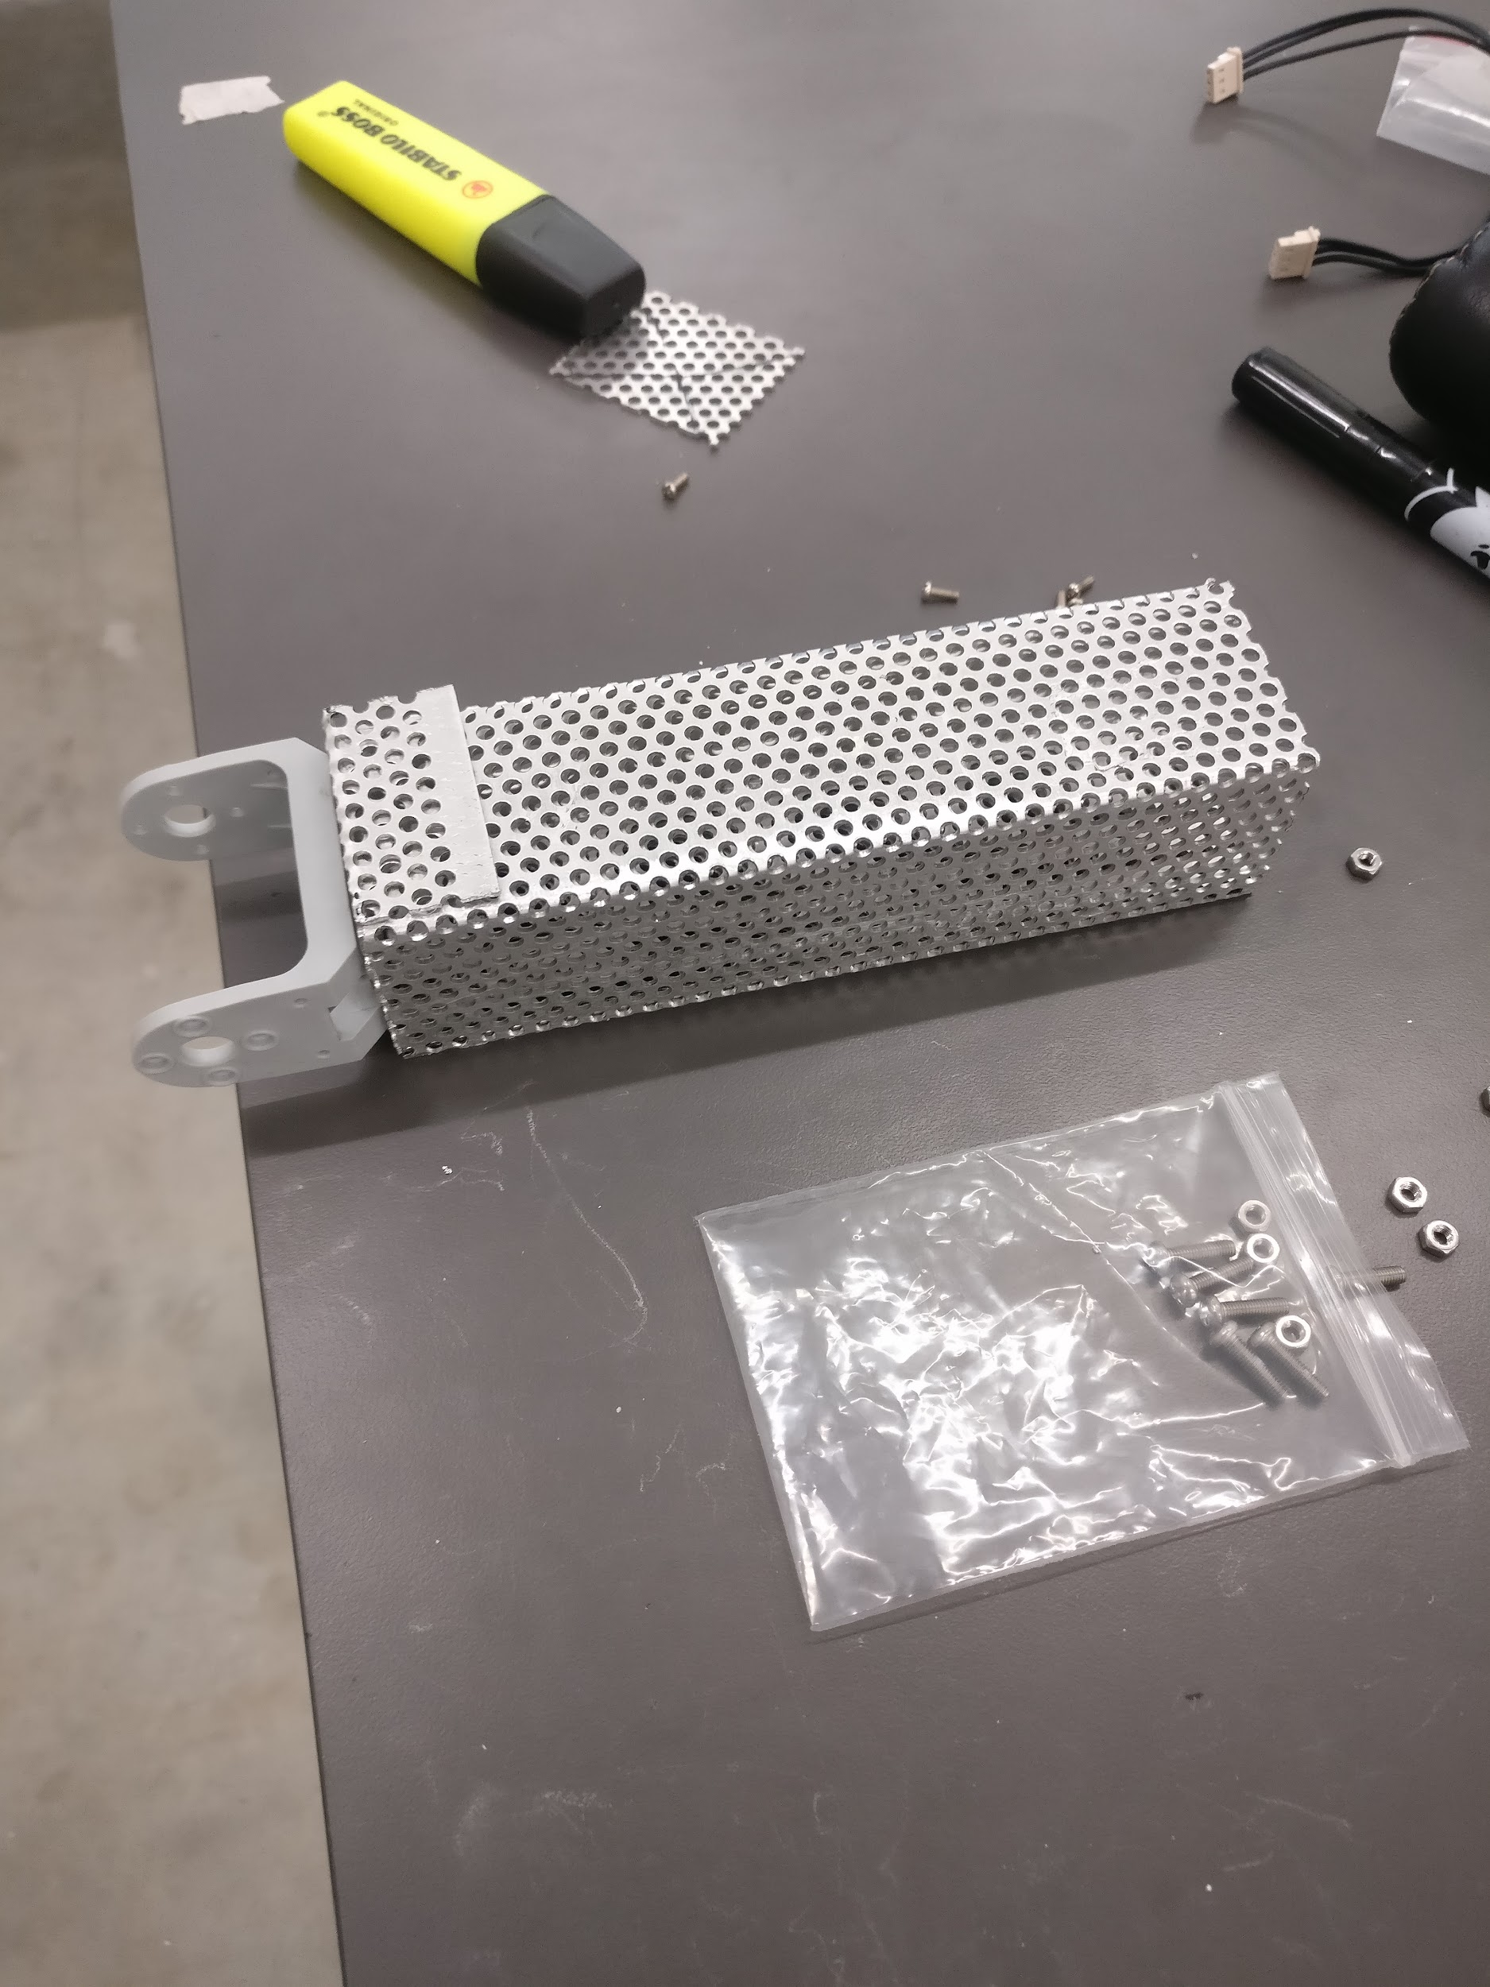
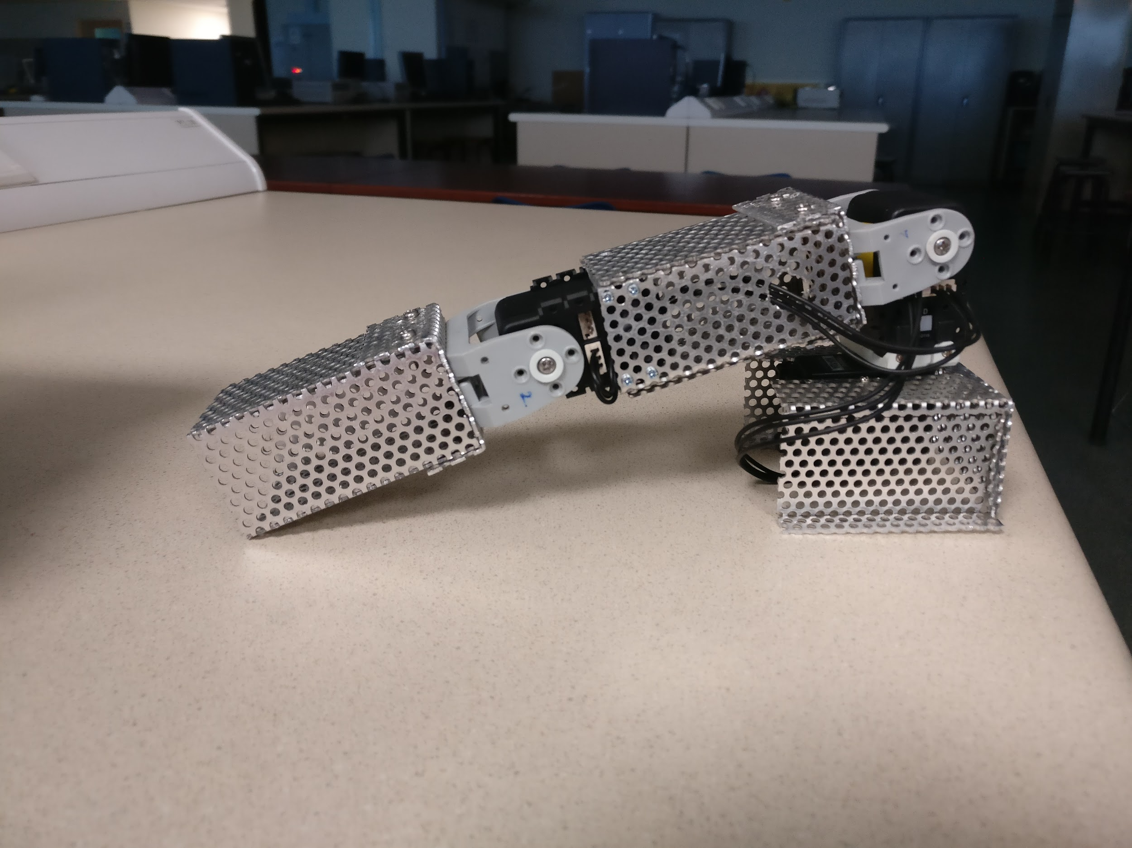
Hardware: Testing
Difficulties:
Robot tipping over
Wheels not enough friction
Not enough torque to cut the wire

Slide 14
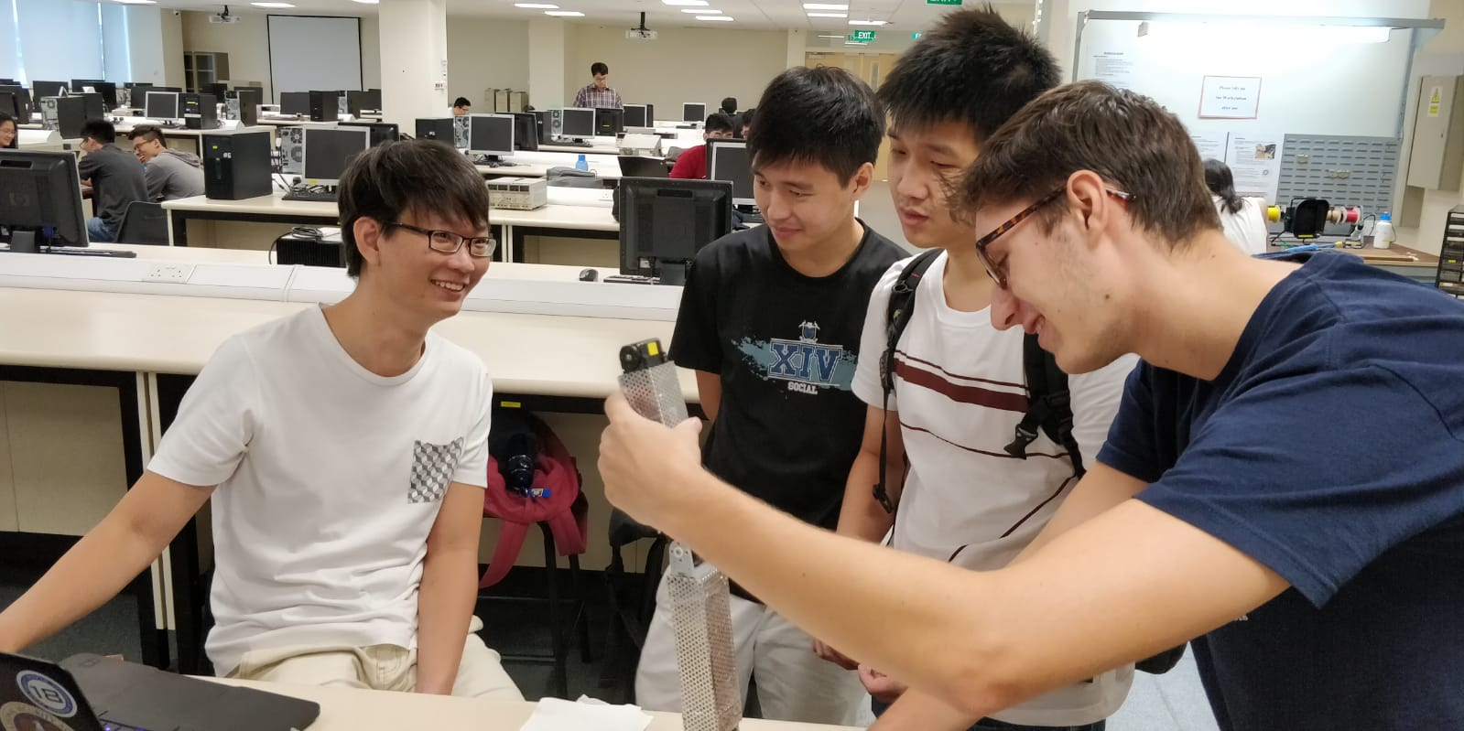
Hardware: Redesign
Solutions:
Adding more support
Changing orientation arm
Change wire material

Slide 15
Software
Controlling the robot: Computer Vision with inverse kinematics

Slide 16

Why we never use ?
Collaborative environment
- small inhouse project
2. Not realtime.
- Threads instead
3. Focus on communication algorithm

Slide 17



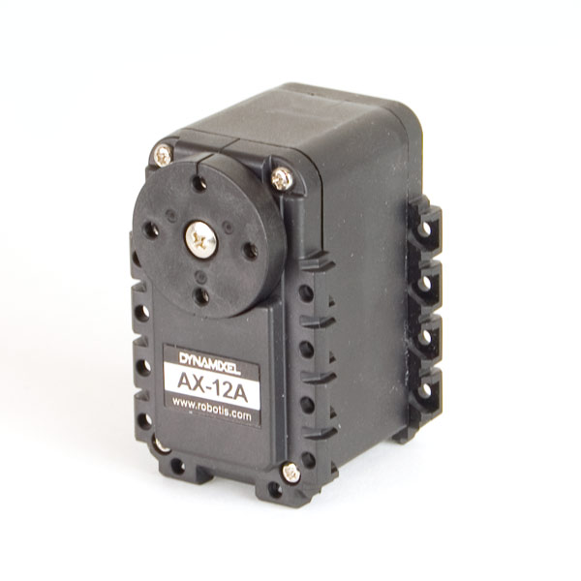

Overview

Slide 18
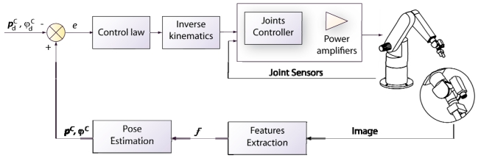
Visual Servoing

Slide 19
CNN?

Slide 20
Convolution neural Network
hand craft
End to end learning
vs traditional image detection

Slide 21


Slide 22
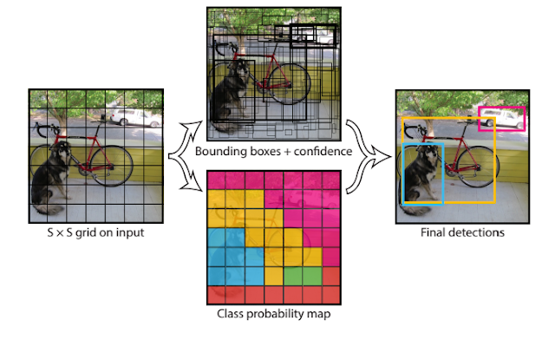
You Only Look Once (YOLO)
By Joseph Redmon
https://arxiv.org/pdf/1506.02640.pdf

Slide 23
Architecture
 | Computer Vision | Inverse Kinematics
Feed Forward | Convolution Neural Network (CNN) | Homogenous matrix
Loss function | Mean Square Error (MSE) Sigmoid Cross Entropy | Sum Square Error (SSE)
Optimizer | Adam Optimizer (1st order derivative & momentum) | Newton Method (2nd order derivative)
So what is AI?
There is no such thing as Artificial intelligence: Notes on the myth of AI
https://ericplatt.com/there-is-no-such-thing-as-artificial-intelligence/

Slide 24
Conclusion
!
!
!

Slide 25




Modular Design
Notes:
Maybe this slide is irrelevant and can be saved for questions

Slide 26

Appendix

Slide 27
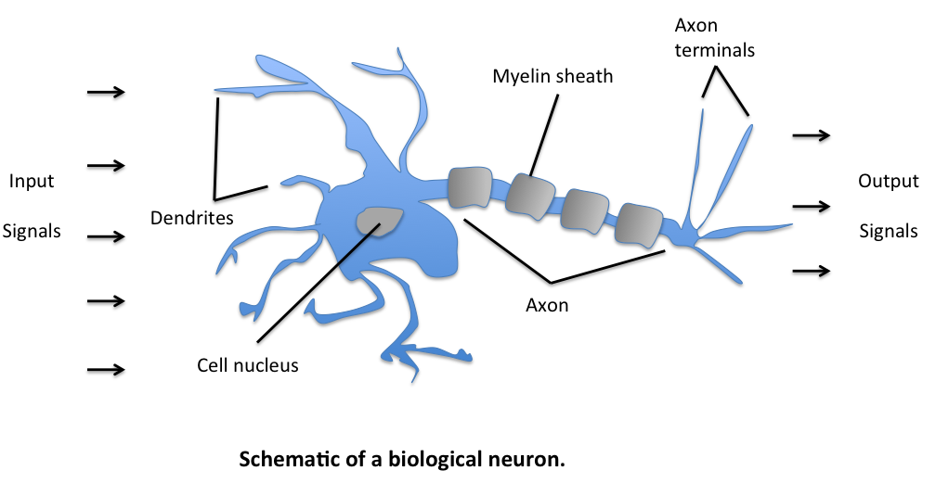
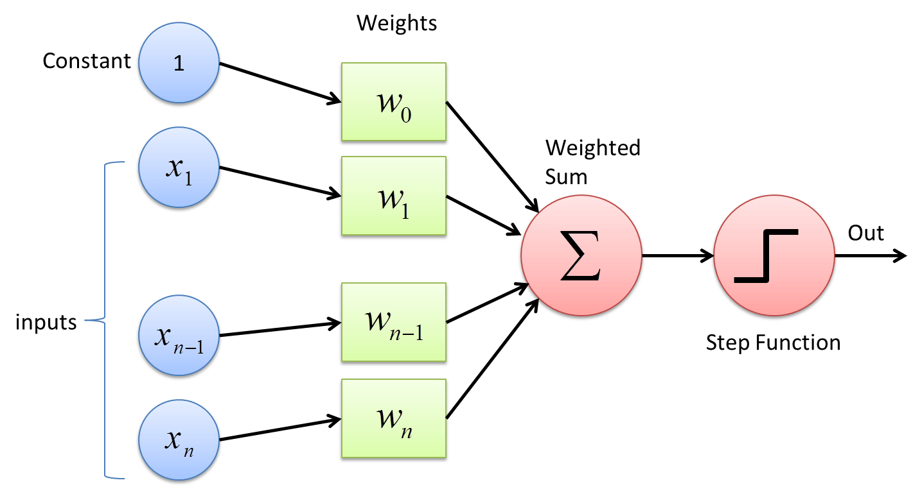
Biological Neuron & Perceptron

Slide 28
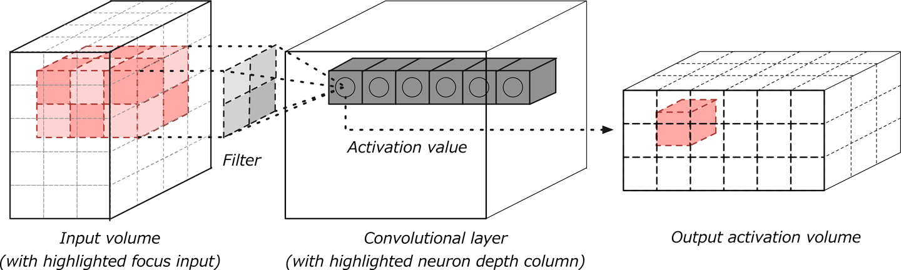
Convolution Neural Network (CNN)

Slide 29
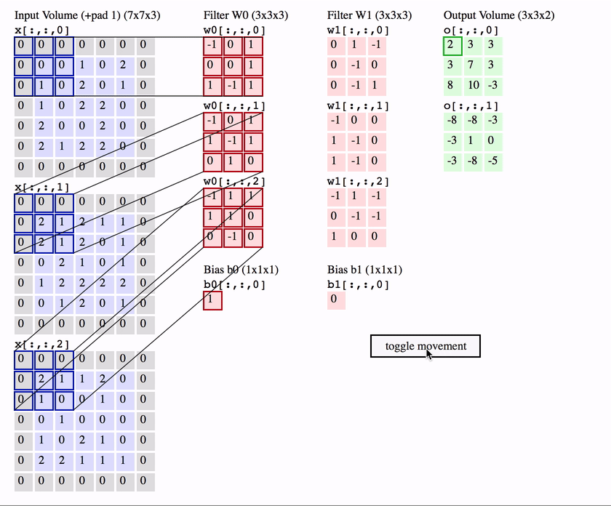

Slide 30
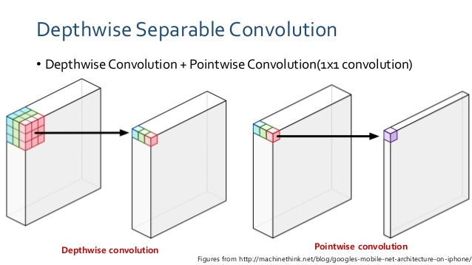
A CNN Accelerator on FPGA Using Depthwise Separable Convolution
https://arxiv.org/pdf/1809.01536.pdf

Slide 31
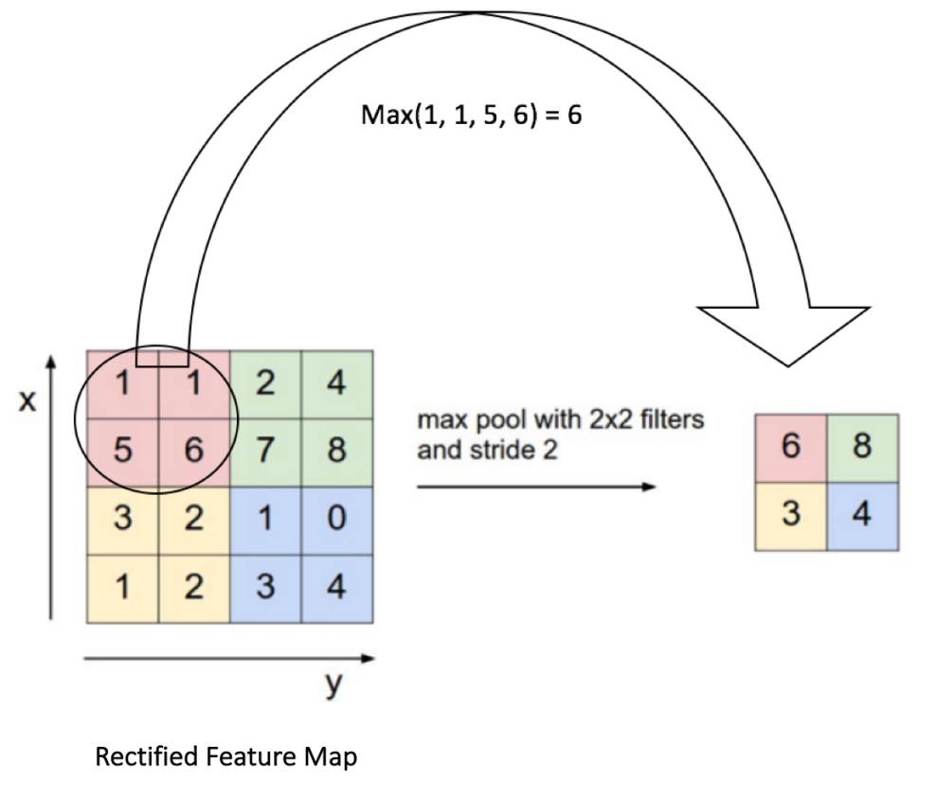
Max pooling

Slide 32
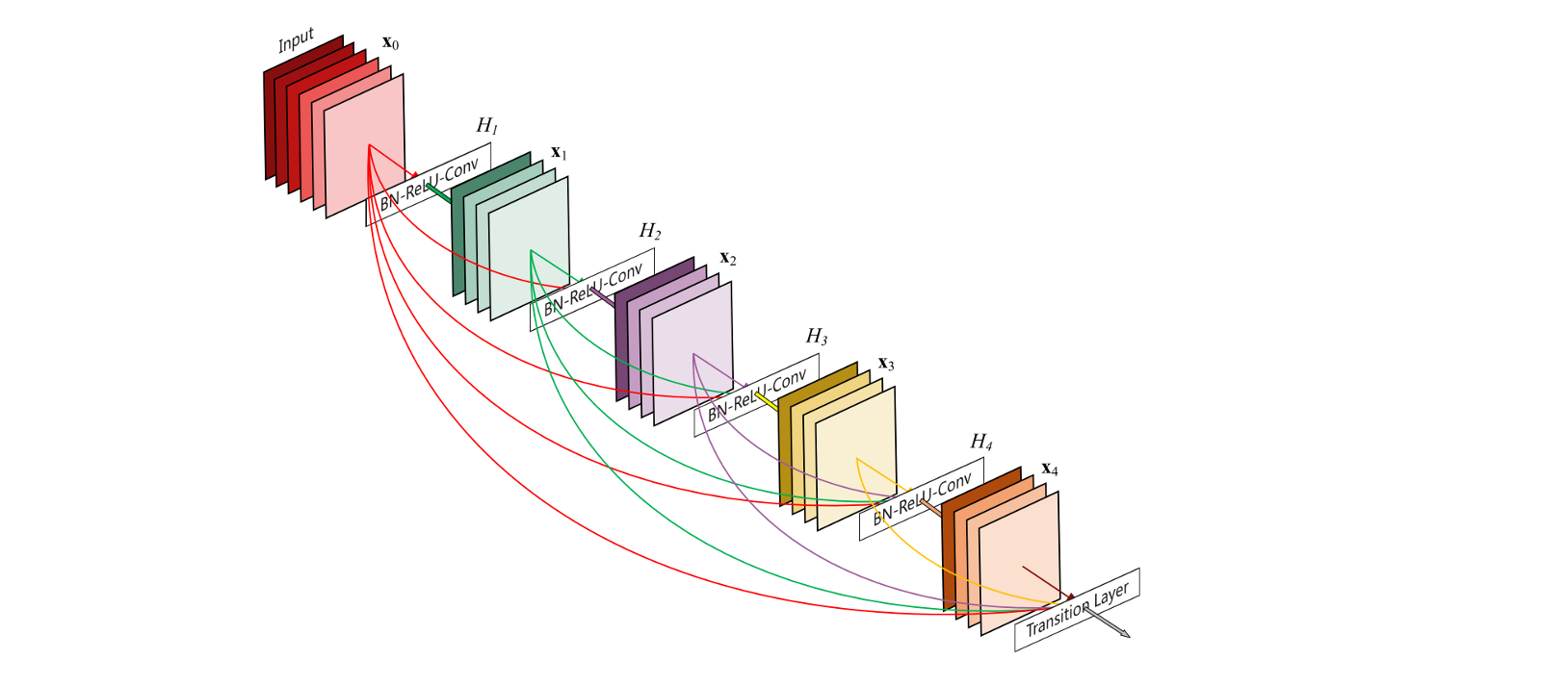
Dense block
Densely Connected Convolutional Networks
https://arxiv.org/pdf/1608.06993.pdf

Slide 33

Nonlinearity

Slide 34
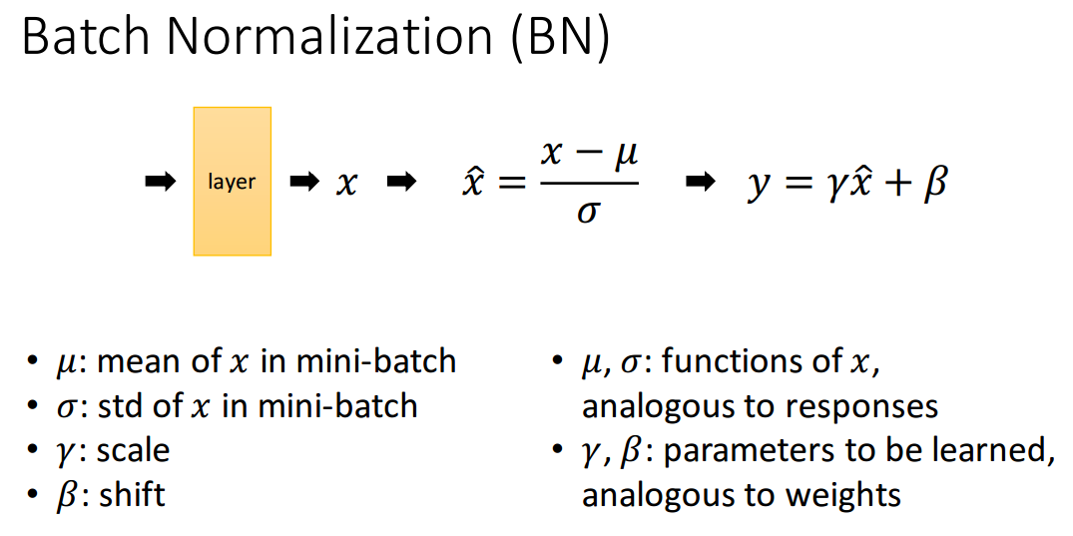
Reduce Internal covariance shift between layers
BN makes the landscape of the corresponding optimization problem be significantly more smooth.
https://arxiv.org/pdf/1805.11604.pdf

Slide 35
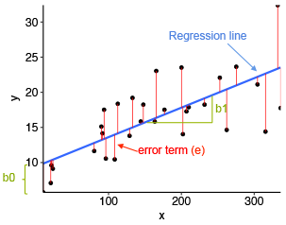
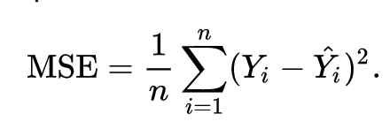
Linear regression
Use to compute the variable:
X
Y
Width
Height

Slide 36
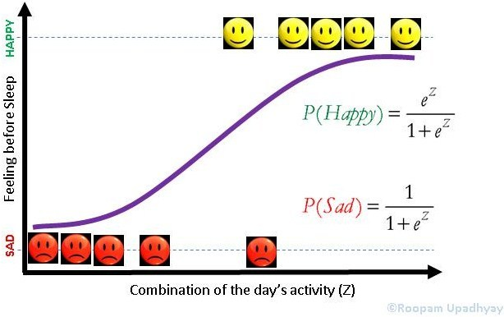
Logistic regression
Use to compute the variable:
Probability of the bounding box
Category of the Object

Slide 37
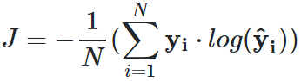
Cross-Entropy
Entropy is a measure of disorder.
Its is to quantify the difference between two probability distributions
The cross entropy method for classification
http://citeseerx.ist.psu.edu/viewdoc/download?doi=10.1.1.324.4845&rep=rep1&type=pdf
Notes:
J=−1N(∑i=1Nyi⋅log(y^i))

Slide 38
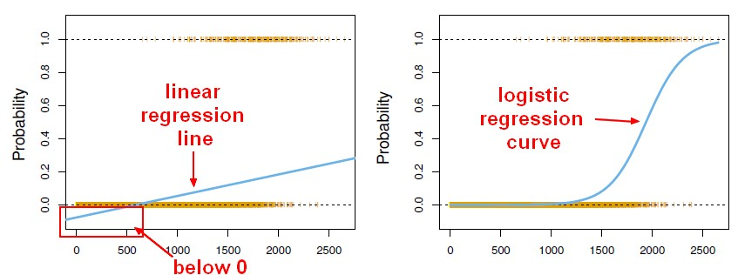
Linear vs logistic regression
Highly sensitive to outliers. (not robust)
Limited Outcome Variables. For classification task

Slide 39

Gradient descent
1st order derivative

Slide 40


Optimizer

Slide 41
Adam optimizer
Adaptive Gradient Algorithm (AdaGrad)
Root Mean Square Propagation (RMSProp)
Advantages:
1. Straightforward to implement.
2. Computationally efficient.
3. Little memory requirements.
4. Invariant to diagonal rescale of the gradients.
5. Well suited for problems that are large in terms of data and/or parameters.
6. Appropriate for non-stationary objectives.
7. Appropriate for problems with very noisy/or sparse gradients.
8. Hyper-parameters have intuitive interpretation and typically require little tuning.
Adam: A Method for Stochastic Optimization
https://arxiv.org/pdf/1412.6980.pdf

Slide 42
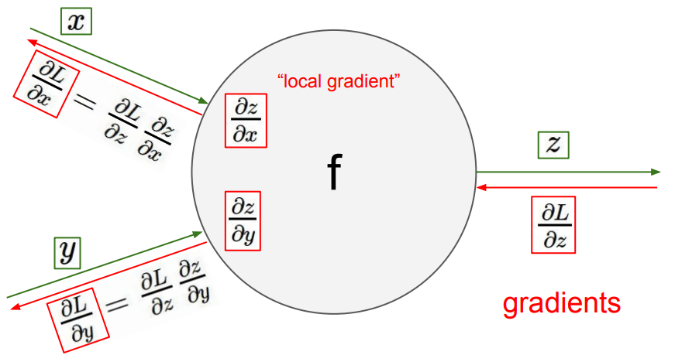
Back Propagation

Slide 43
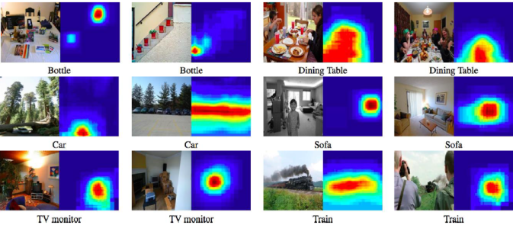
Feature extraction

Slide 44
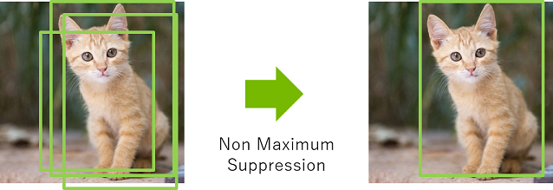
Non-Maximum Suppression
Learning To Filter Object Detections
http://www.nowozin.net/sebastian/papers/prokudin2017objectdetections.pdf

Slide 45
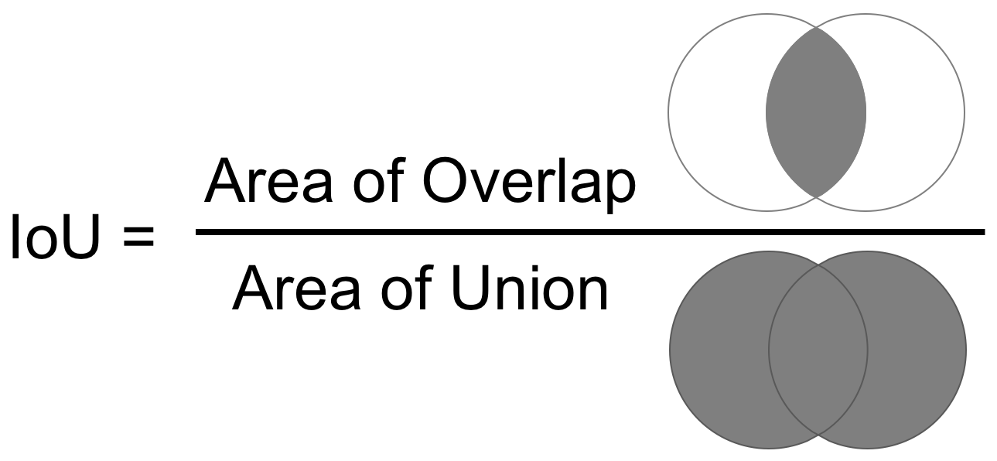
Intersection over Union

Slide 46
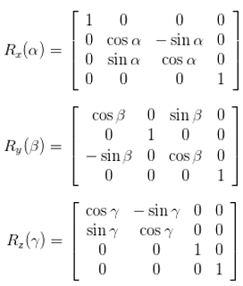
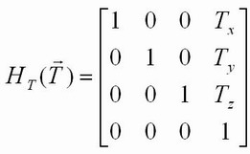
Forward Kinematics
1. Define variable for homogeneous matrix
Link
Joint

Slide 47
Forward Kinematics
2. Set the axis of rotation and translation
Rotation about y axis
Translate along z axis by 3m
Translate along x axis by 1m
Rotation about x axis
Rotation about z axis
Translate along y axis by 2m
[‘z’,[1,0,0], ‘y’,[0,0,3], ‘x’,[0,2,0]]
3 joints with 3 links

Slide 48
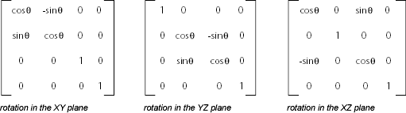
Forward Kinematics
3. Define the angle of rotation
Default for θ is 0 (at origin)

Slide 49
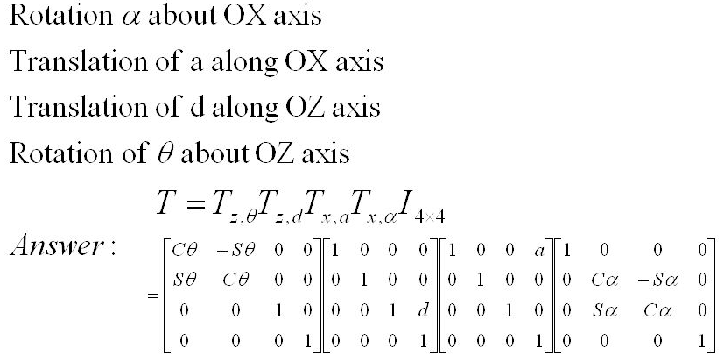
Forward Kinematics
Compute the coordinates at the end effector

Slide 50
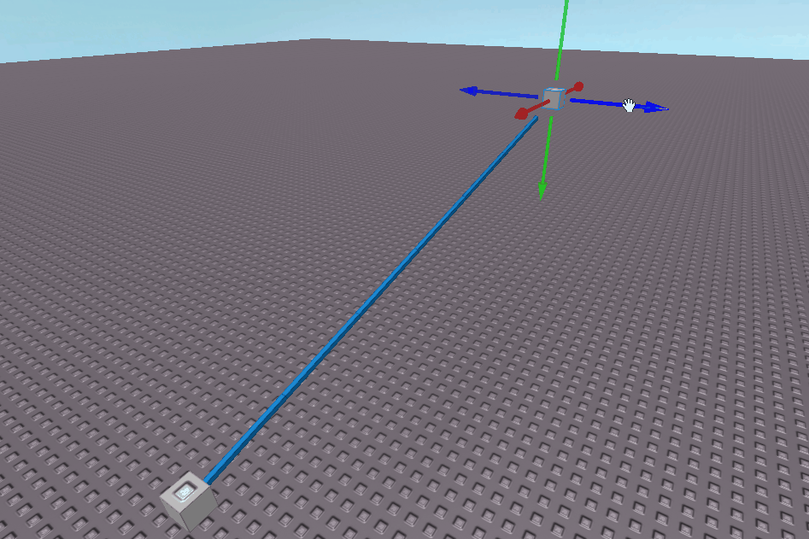
Solving Inverse Kinematics
Blue line is the loss function

Slide 51
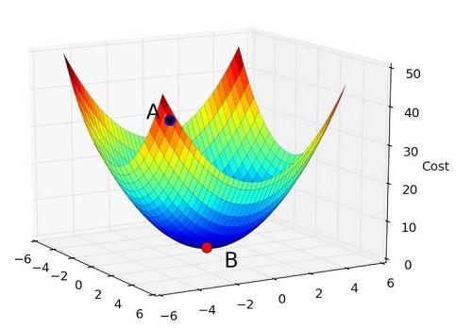
Intuition
Loss function is differentiable and trainable
Target

Slide 52
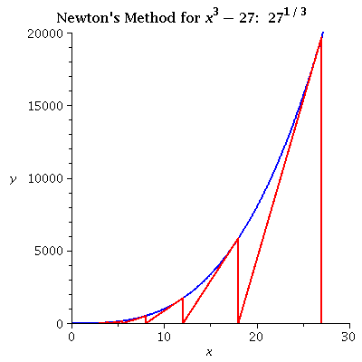
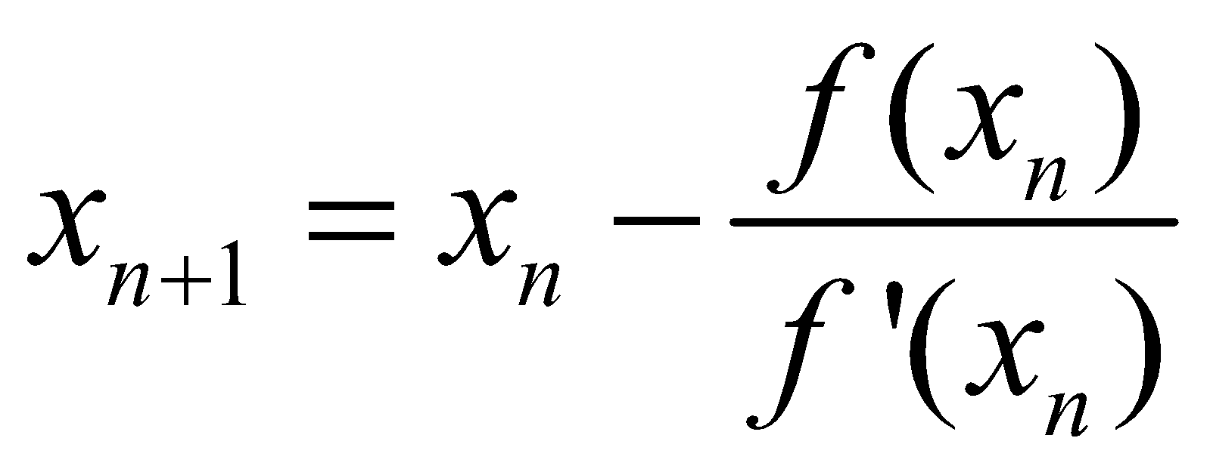
Newton method
2nd order derivative

Slide 53
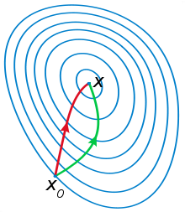
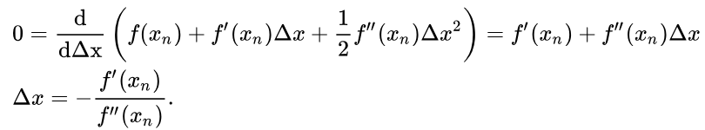
Newton's method in optimization
Using Taylor series to approximate
A comparison of gradient descent(green) and Newton's method (red) for minimizing a function (with small step sizes). Newton's method uses curvature information to take a more direct route.
Newton's method is applied to the derivative f ′.

Slide 54
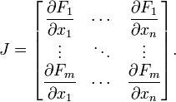
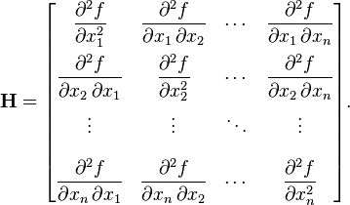
Newton's method for matrix
Jacobian matrix is the matrix of all first-order partial derivatives of a vector-valued function.
The Hessian matrix is a square matrix of second order partial derivatives of a scalar valued function f .

Slide 55
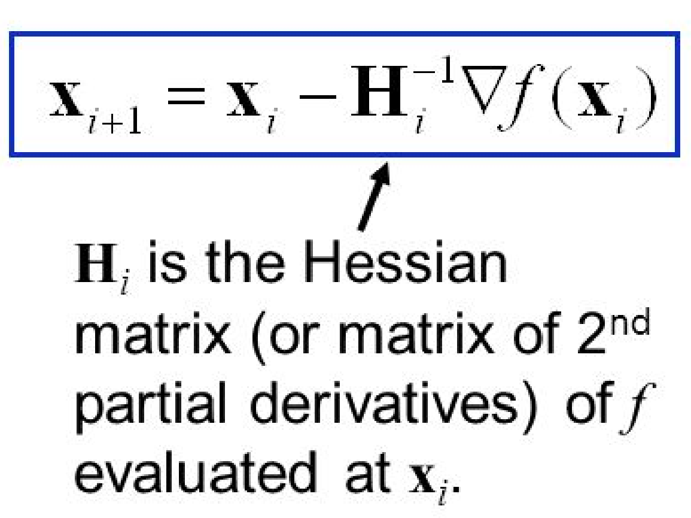
Compute Newton's method
Updated variable
Jacobian matrix

Slide 56
Gradient descent | Newton method
Easy to implement | More computation
scalable | Not scalable (O(N³) operations)
More iteration | Less iteration

Slide 57
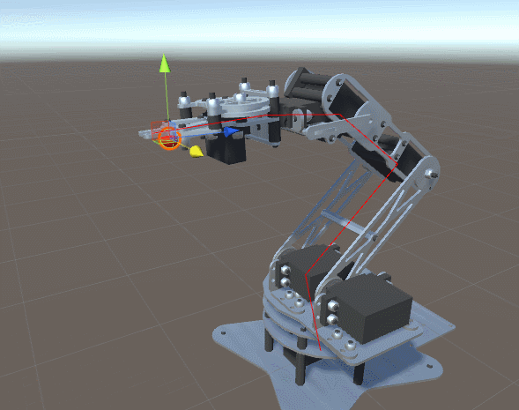
Solving Inverse Kinematics
Newton method optimization stop when the loss is within a certain threshold or it is less than max iteration

